Slide 1




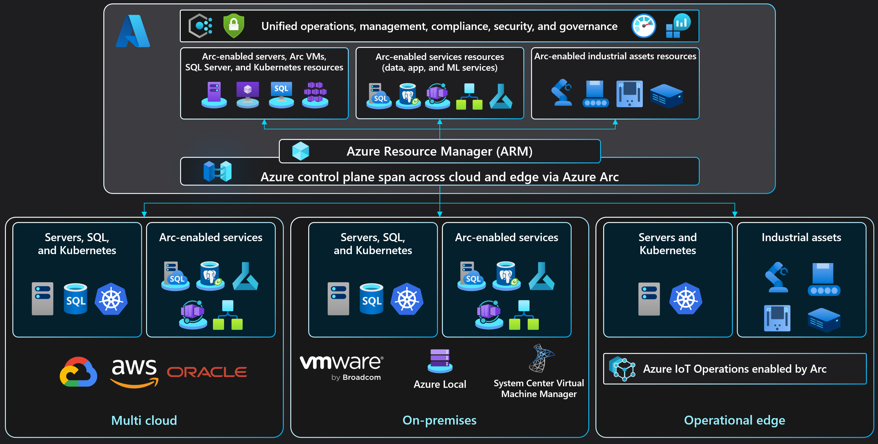
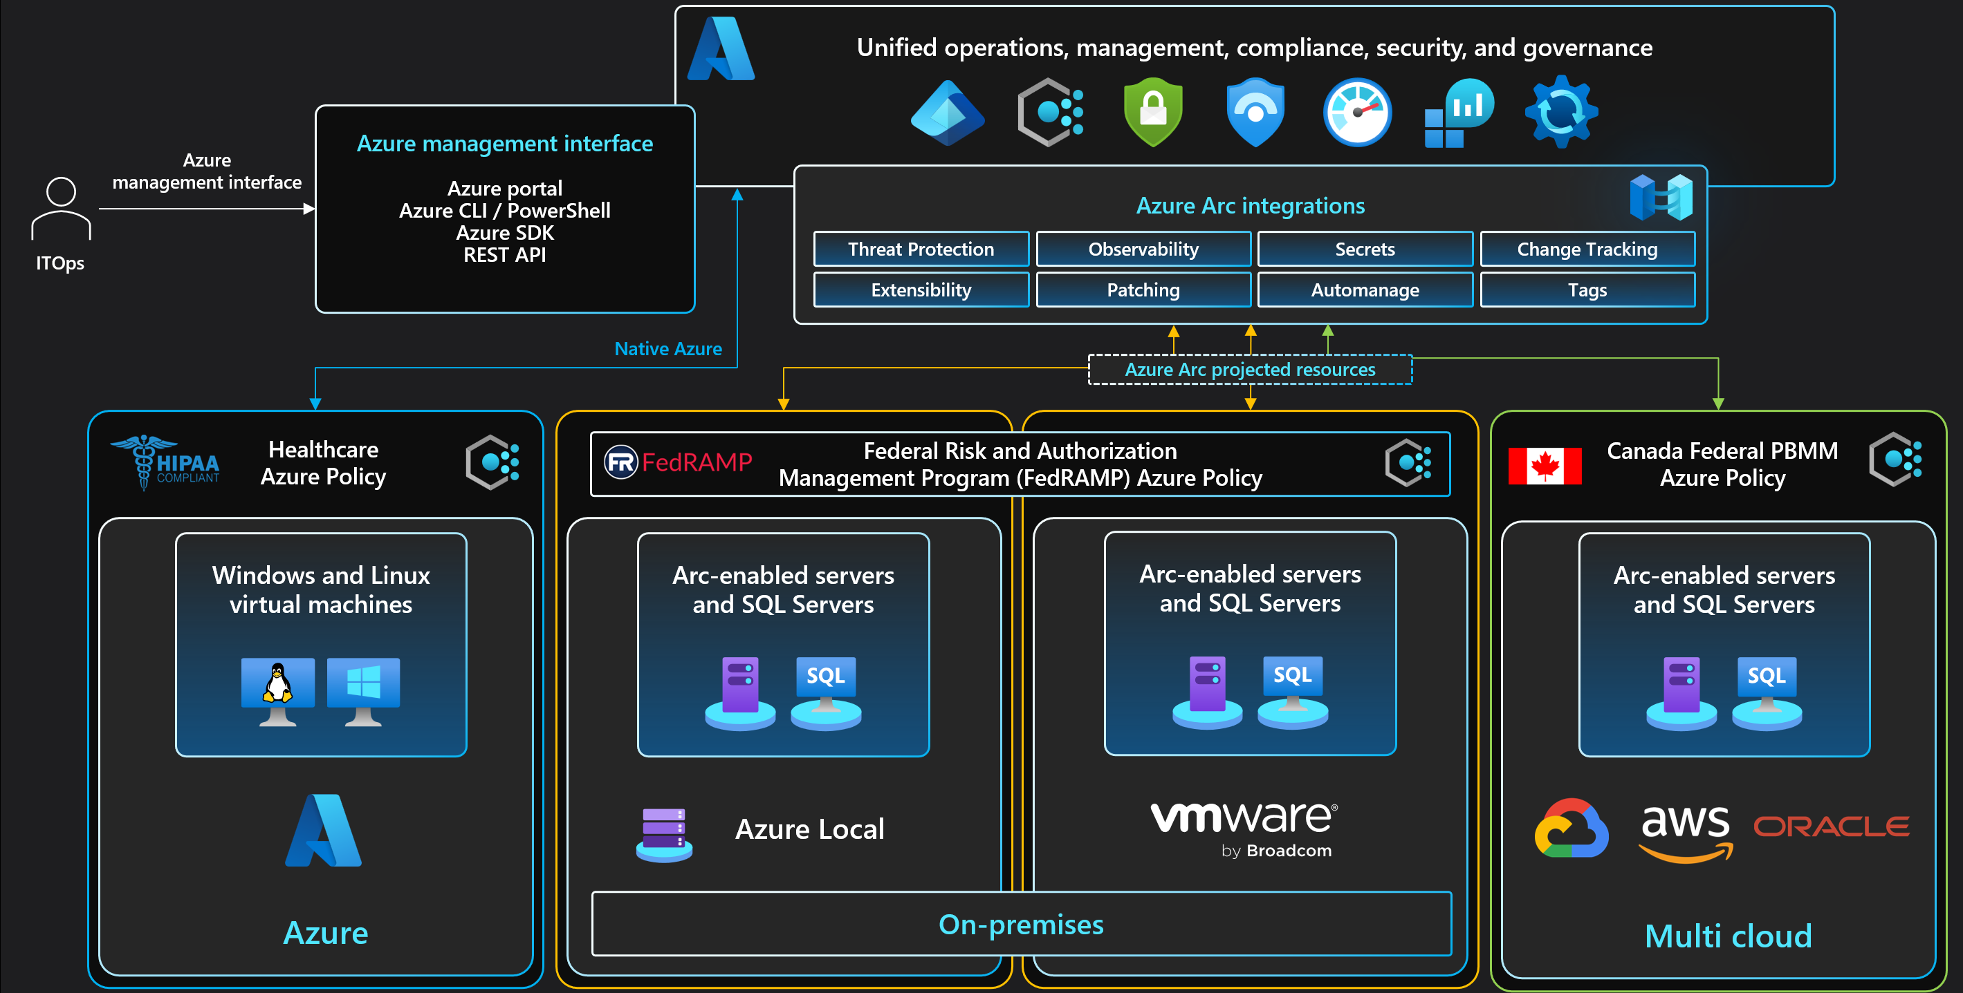





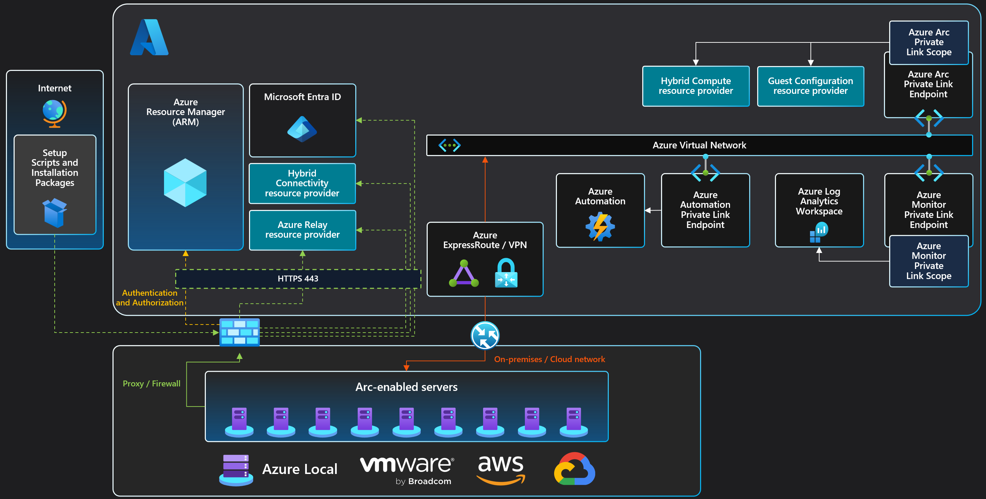





Azure Arc-enabled servers
Azure Arc solution architecture
Compliance options view
Connected Machine agent architecture
Azure management interface
Azure Arc Connected Machine Agent
Configuration passed to the Agent:
Subscription and resource group
Azure Region to store metadata
Network options (direct, proxy, or private link)
Credential to onboard (device login, AAD token, or SPN)
ITOps
HTTPS 443
Microsoft Entra ID
Azure portal
Azure CLI / PowerShell
Azure SDK
REST API
Hybrid Instance Metadata Service (HIMDS)
Handles managed identity and metadata sync (heartbeats)
Azure Resource Manager (ARM)
Authentication & Authorization
Guest Configuration
Provides In-Guest Policy and Guest Configuration functionality, such as assessing whether the machine complies with required policies
Hybrid Compute
resource provider
Hybrid Connectivity resource provider
Extension Manager
Manages VM extensions, including install, uninstall, and upgrade
Guest Configuration
resource provider
Custom Script
Microsoft Defender for Endpoint (MDE)
Azure Monitor Agent (AMA)
Azure Monitor multiple resource provider
Identity and access management
Private Link integration
Azure Key Vault Integration
1a
Create service principal and a short-lived client secret with Azure admin
Microsoft Entra ID
Public Key Infrastructure (PKI)
Microsoft Entra ID
ITOps
Azure administrator
Service Principal
Managed Identity
Entra ID user
ITOps
6
AKV is configured with Azure Managed Identity for allowing the Arc-enabled server to access certificates
1b
Grant “Azure Connected Machine Onboarding” role to service principal for least privileged access
3b
Managed Identity is created in Azure AD enterprise applications
Upon renewal time, the certificates are renewed only in AKV (renewed PKI certs can be uploaded as well)
1b
1c
Grant “Azure Connected Machine Resource Administrator” role to server admin for least privileged access
Azure Resource Manager (ARM)
AKV Extension background service request for a Managed Identity token in order to retrieve certificates
3a
2a
Login to Azure portal and generate server onboarding script
Hybrid Compute
resource provider
Guest Configuration
resource provider
Log Analytics Workspace
1a
Azure Key Vault (AKV)
3b
Arc-enabled server
Extensions are managed using Azure token obtained with managed identity credentials
6
5
Guest configuration updates are managed using Azure token obtained with managed identity credentials
IT Ops administrator deploy Azure Key Vault
User certificates
AKV Extension background service
retrieve AKV certificates based on interval specified in the extension configuration. The AKV agent will then sync down the new certificate and private key automatically at its next sync interval
Arc-enabled server
AKV Extension Background Service
App/Service
(i.e. Web Server)
3a
Azure Arc-enabled server resource is created using service principal credentials
Monitoring agent configuration and workspace tokens obtained with managed identity credentials
Certificates URIs are used as parameters and syncs based on user-defined time intervals
Connected Machine Agent
5
App/Service consumes local cert store certificate
(as well rebind upon renewal)
ITOps
Server administrator
Host Instance Metadata Service (HIMDS) managed identity credentials
Guest Configuration Extension service
Guest Configuration
Arc service
Azure Monitor Agent (AMA)
2a
Hybrid Compute resource provider
2b
2b
Using RDP/SSH or automation tooling login to server with local admin rights
7
AKV extension is deployed on the Arc-enabled server
Extension service
4
Cert Store
Run server onboarding script by providing service principal and client secret
HIMDS service is created and runs under NT Service\himds virtual account with least privileges
3d
3e
Azure Update Manager
The certificates and private keys are stored in the local certificate store (Windows) or as files in a directory (Linux)
2c
3g
Guest configuration extension service is created and runs under Local System account
Guest configuration Arc service is created and runs under Local System account
Run Command
4
3c
Managed Identity credentials are stored in local storage using ACL
Hybrid agent extension applications local security group is created to authorize members to request Azure tokens through HIMDS service
Extensions are created using Local System account privileges of extension service
3f
Copyright @ 2025 Microsoft. All rights reserved. v1.9 #ArcJumpstart | aka.ms/JumpstartGems

